Slide 1
One degree of freedom: θ
Two degrees of freedom: θ₁ and θ₂

Slide 2
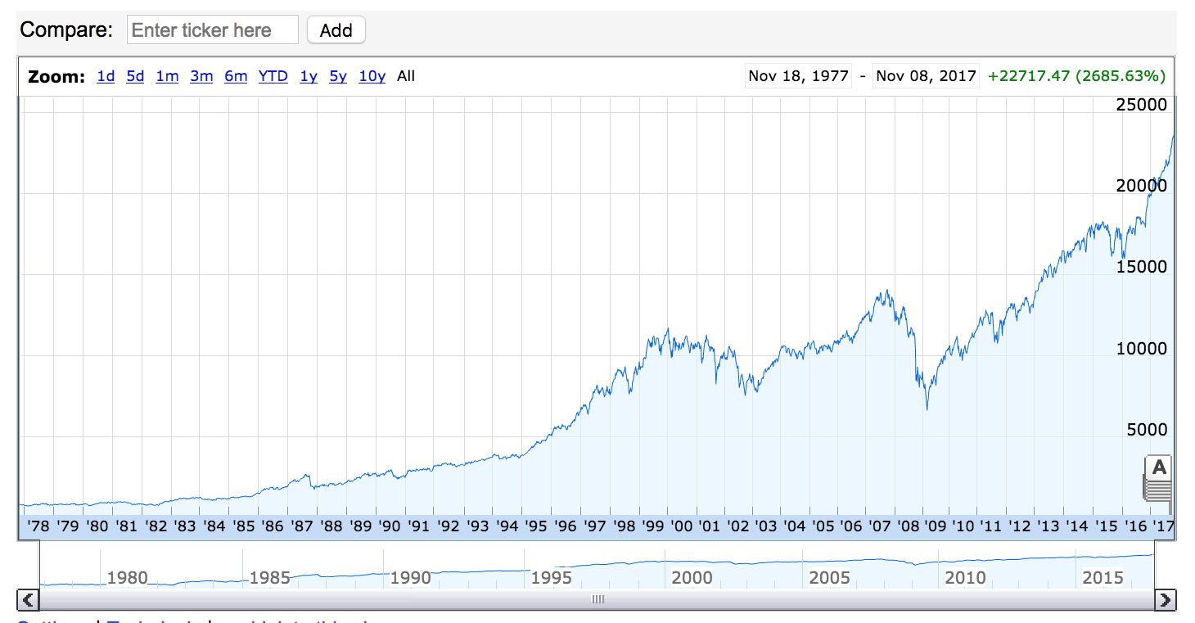
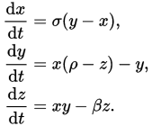
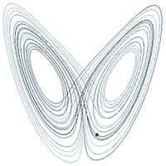
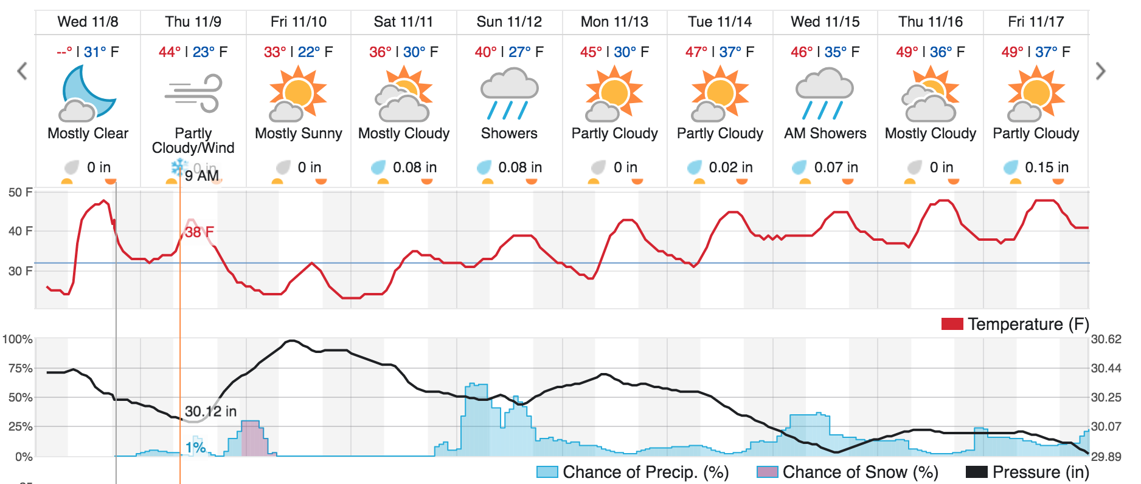
Chaos!
Complex systems are extremely sensitive to initial conditions.

Slide 3

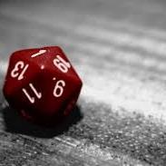
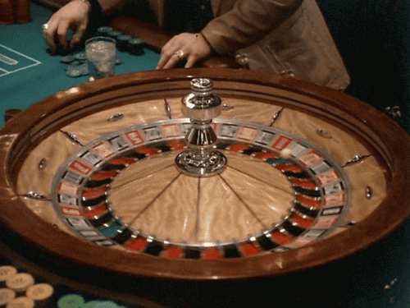

Unpredictable Systems

Slide 4

Probability and Statistics

Slide 5

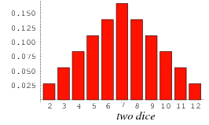
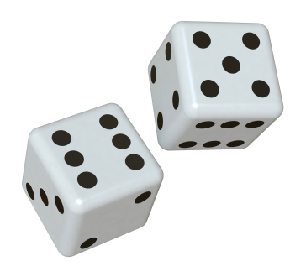
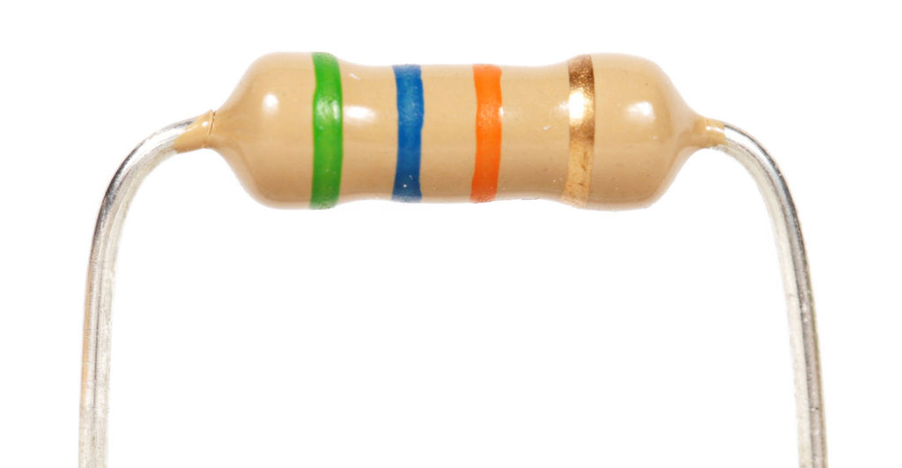
Probability and Statistics
Pair of Dice
Manufactured Resistors

Slide 6
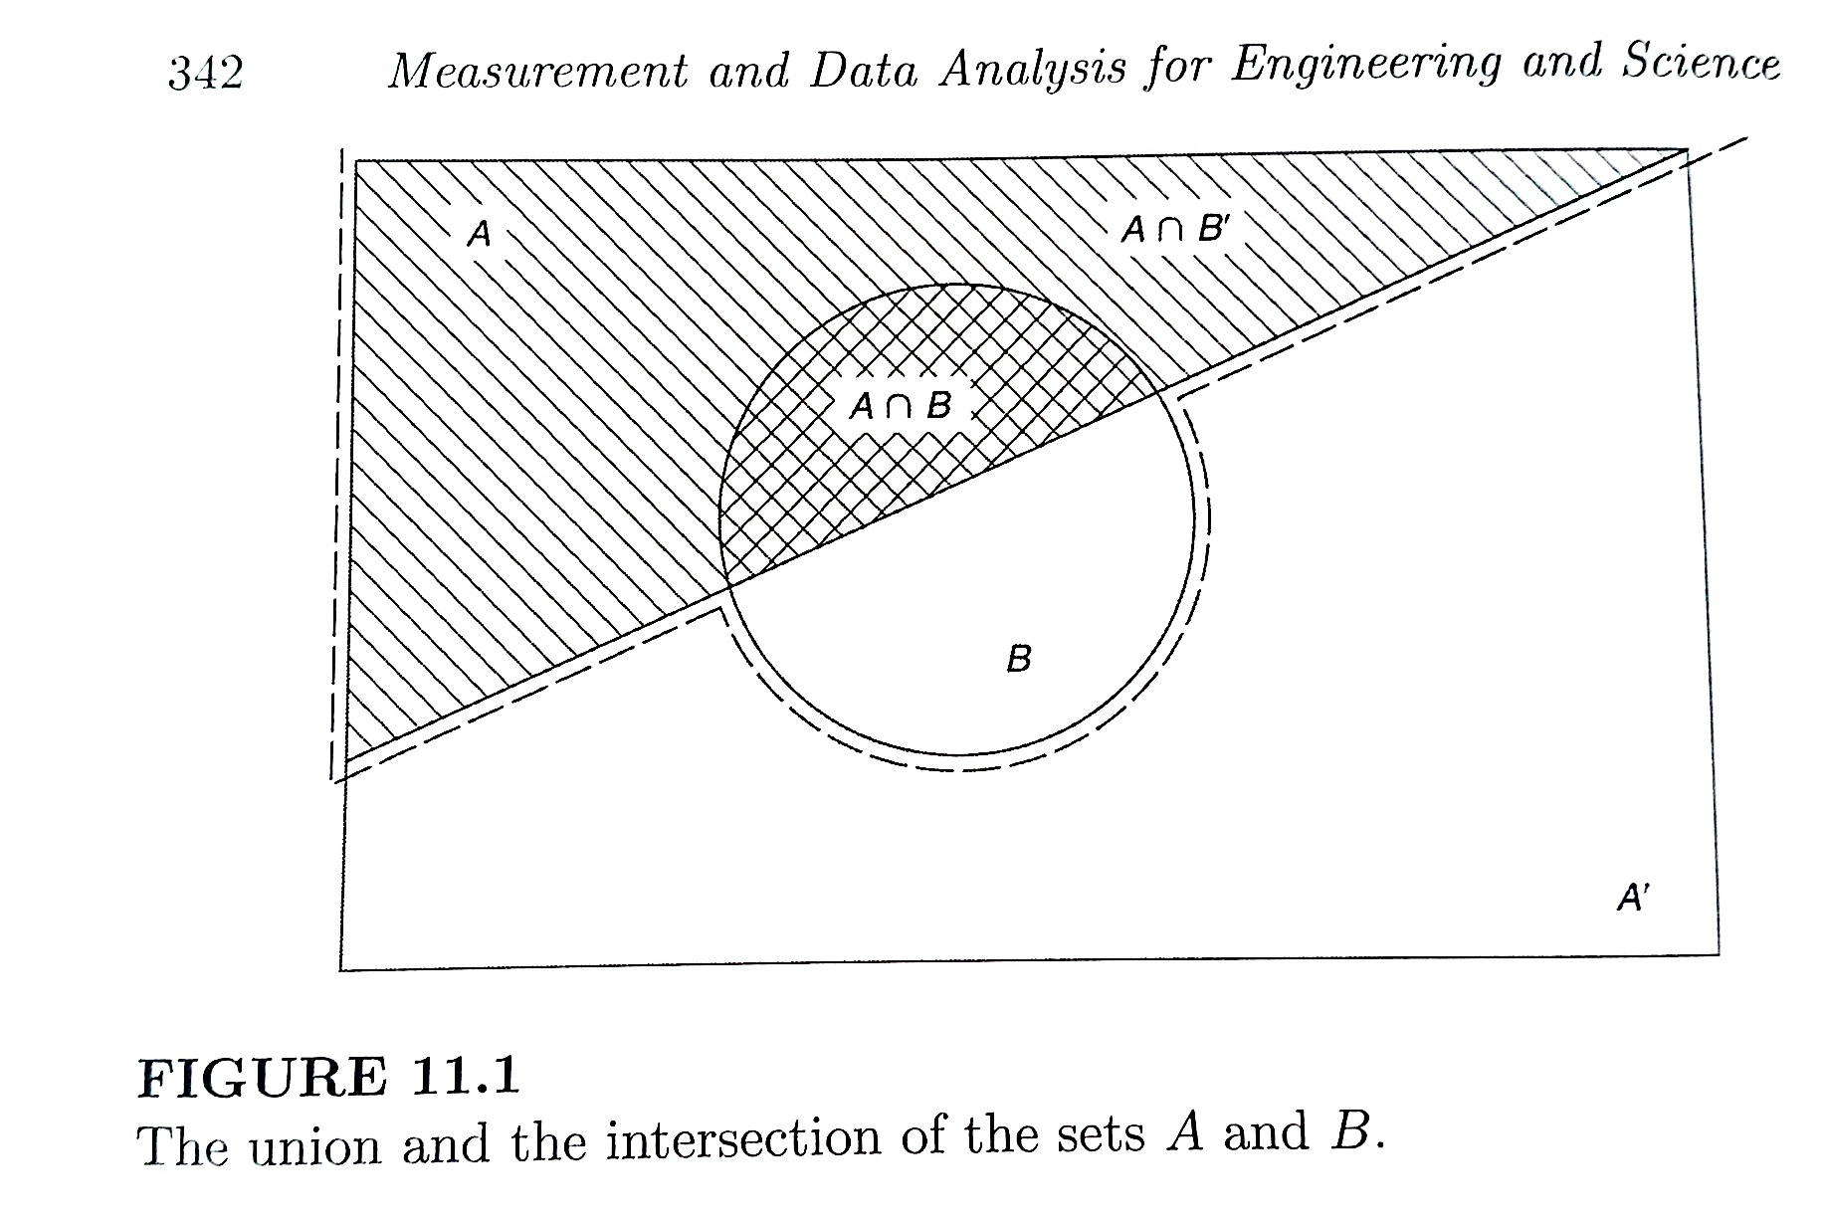
Probability – Venn Diagrams
Intersection “AND”
Union “OR”

Slide 7
Plinko Board
For a board with n rows of pegs,
prob. of landing in k^{th} bin:
k =
Prob. of going left or right: a = 0.5

Slide 8
Probability and Statistics
Pair of Dice
Manufactured Resistors

Slide 9
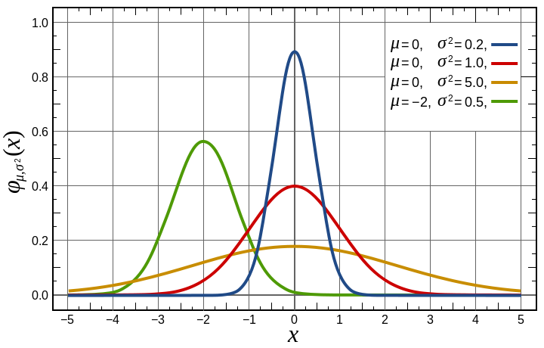
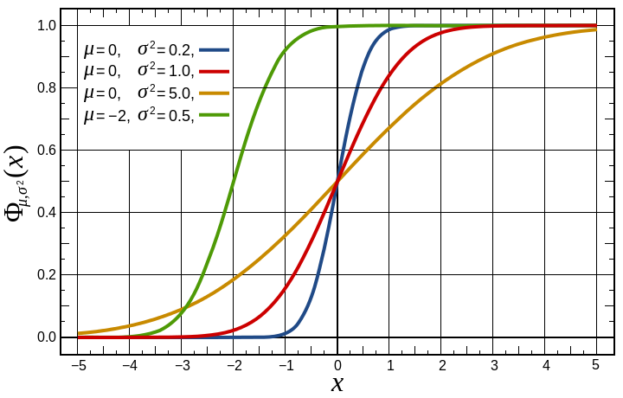
Gaussian Distribution
Central Limit Theorem – For large N, most distributions become Gaussian
Gaussian PDF
Gaussian CDF

